Slide 1
Unit 2 Continue
Presented By:Er.Sudan Prajapati

Slide 2
Data Mart
A data mart contains a subset of corporate wide data that is value to specific group of users.
The scope is confined to a specific selected subjects
For e.g: A marketing data mart may confine its subject to customer, item and sales.
The data containing a data mart tends to be summarized.
Data mart is basically a condensed and more focused version of a data warehouse that reflects the regulations and process specifications of each business unit within an organization.
Each data mart is dedicated to a specific business function or region.
This subset of data may span across many or all of an enterprise functional subject areas.
In compare to the data ware house data marts are usually smaller and focused on a particular subject or department.

Slide 3
Data Mart
An enterprise ware house collects of all information about subjects spanning the entire organization.
It provide corporate wide data integration usually from one or more operational system or external information providers and cost functional in scope.
It typically contains detailed data as well as summarized data and can range in size from few gigabytes to beyond tera bytes an enterprise data ware house may be implemented on traditional mainframes computer super servers or parallel architecture.
It requires extensive business modeling and takes lot of time to design to build.

Slide 4
Virtual Warehouse
A virtual warehouse is set of view over operational database for efficient query processing only some of the possible summary views may be materialized a virtual warehouse is easy to build but requires access capabilities on operational database server.
Create Virtual view of databases as opposed to a physical warehouse.
Create single "virtual database" from all the data resources.
Data resource can be local or remote • Data is not move from sources but users are given direct access to the data
Access to data may be : simple SQL queries, view definition, data-access middleware
Possible to access remote sources : major RDBMS
Client application access data distributed across multiple data sources through a single SQL statement, a single interface
All data sources are accessed as though they are local users and their applications don't even need to know the physical location of the data

Slide 5
Virtual Warehouse
Advantages
Don’t need to replicate information
Don’t need to maintain separate physical storage
Initially easy and fast
Disadvantages
Live performance may be degraded as some resources will be used for analytical purpose
Since there is no metadata, no summary data, history, all query must be repeated, creating an additional burden on the system
No clearing and refreshing process : queries became complex

Slide 6
Distributed Data Warehouse
A Distributed Data Warehouse is similar in most respects to a Central Data Warehouse, except that the data is distributed to separate mini Data Warehouses (Data Marts ) on local or specialized servers
Business is distributed geographically or over multiple, differing product lines.
The data warehouse environment will hold a lot of data, and the volume of data will be distributed over multiple processors.

Slide 7
The data copied into a data warehouse does not change (except to correct errors). The data warehouse is a historical record of the state of an organization.
The frequent changes of the source OLTP systems are reflected in the data warehouse by adding new data, not by changing existing data.
Data warehouses are subject oriented, that is, they focus on measuring entities, such as sales, inventory, and quality.
OLTP systems, by contrast, are function oriented and focus on operations such as order fulfillment.
In data warehouses, data from distinct function-oriented systems is integrated to provide a single view of an operational entity.
Data warehouses are designed for business users, not database programmers, so they are easy to understand and query.

Slide 8
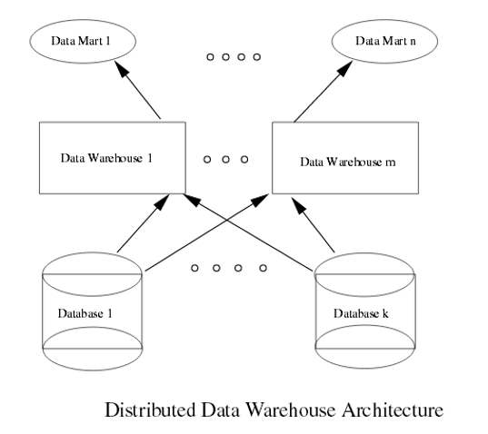

Slide 9
Meta Data
Meta Data is simply defined as data about data meaning that data that is used to represent other data is known as meta data.
For e.g: The preface or index of book serves as a meta data for the contents in the book.
In terms of data warehouse meta data can be defined as follows:
Meta data is the road map to data warehouse.
Meta data in a data warehouse defines the warehouse objects.
Meta data acts as a directory which helps in the decision support system to locate the content of a data warehouse.

Slide 10
Categories of a meta data:
Business meta data: It has the data ownership information, business definition and changing policies .
Technical meta data: It includes database system names, tables, columns, size and data types. It also includes structure information such as primary and foreign key attributes and indices.
Operational meta data: It includes currency of data and data lineage. Currency of data means whether the data is archive, active or purged .
Lineage of data means the history of data migrated and transformation applied on it.

Slide 11
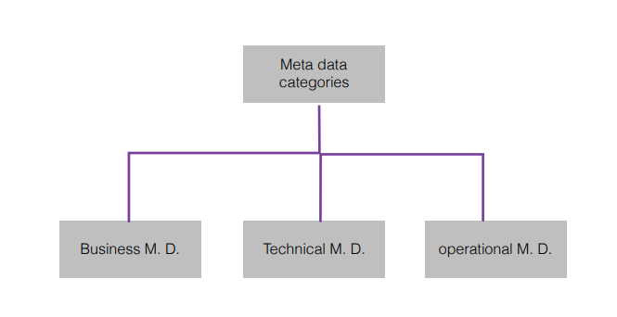

Slide 12
Role of Metadata
Metadata has a very important role in a data warehouse. The role of metadata in a warehouse is different from the warehouse data, yet it plays an important role. The various roles of metadata are explained below.
Metadata acts as a directory.
This directory helps the decision support system to locate the contents of the data warehouse.
Metadata helps in decision support system for mapping of data when data is transformed from operational environment to data warehouse environment.
Metadata helps in summarization between current detailed data and highly summarized data.
Metadata also helps in summarization between lightly detailed data and highly summarized data.
Metadata is used for query tools.
Metadata is used in extraction and cleansing tools.

Slide 13
Role of Metadata
Metadata is used in reporting tools.
Metadata is used in transformation tools.
Metadata plays an important role in loading functions.

Slide 14
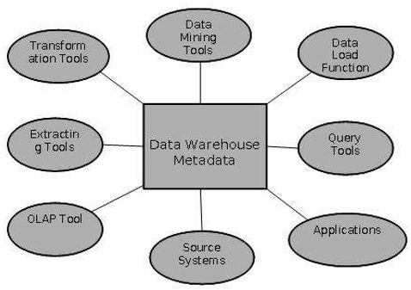

Slide 15
DBMS Vs Data Warehouse
DBMS is the whole system used for managing digital databases, which allows storage of database content, creation/maintenance of data, search and other functionalities.
Whereas a data warehouse is a place that store data for archival, analysis and security purposes. A data warehouse is made up of a single computer or several computers connected together to form a computer system.
DBMS, sometimes just called a database manager, is a collection of computer program that is dedicated for the management (i.e organization, storage and retrieval) of all databases that are installed in the system (i.e hard drive or network).
Data warehouses play a major role in Decision Support Systems (DSS). DSS is a technique used by organizations to develop and identify facts, trends or relationships that would help them to make better decisions to achieve their organizational goals.

Slide 16
The key difference between DBMS and data warehouse is the fact that a data warehouse can be treated as a type of a database or a special kind of database, which provides special facilities for analysis, and reporting while, DBMS is the overall system which manages a certain database.
Data warehouses mainly store data for the purpose of reporting and analysis that would help an organization in the process making decisions, while a DBMS is a computer application that is used to organize, store and retrieve data. A data warehouse needs to use a DBMS to make data organization and retrieval more efficient.

Slide 17
A Multidimensional Data Model
Data warehouse and OLAP tools are based on a multidimensional data model. This model views data in the form of data cube.
A data cube allows data to be modeled and viewed in multiple dimensions. It is defined by dimensions and facts.
In general terms, dimensions are the perspectives or entities with respect to which an organization wants to keep records.
Example:
AllElectronics may create a sales data warehouse in order to keep records of the store’s sales with respect to the dimensions time, item, branch, and locations. These dimensions allow the store to keep track of things like monthly sales of items and branches and locations at which the items where sold.

Slide 18
all
0-D(apex) cuboid
time
item
location
supplier
1-D cuboids
time,location
item,location
location,supplier
2-D cuboids
time,item
time,supplier
item,supplier
time,location,supplier
3-D cuboids
time,item,location
time,item,supplier
item,location,supplier
4-D(base) cuboid
time, item, location, supplierc

